Slide 1
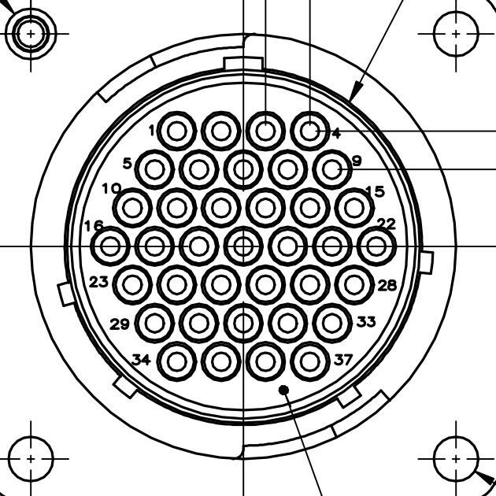
Power, Comms & Thermocouples
Connector Diagram Legend:
P: Power
G: Ground
R+: RS422 receive (positive differential)
R-: RS422 receive (negative differential)
T+: RS422 transmit (positive differential)
T-: RS422 transmit (negative differential)
+: One side of tc
-: Other side tc
Red: Battery
Blue: Comms
Green: Thermocouples
Board Connector: 2-208224-1 or similar
Harness Connector: 206305-1 or similar
Board pinout MATCHES connector pinout
Diagram is for both
connector and board pinout
G
G
G
G
Batt-
P
G
R+
R-
G
Rs-2
P
P
T-
T+
Batt+
P
GP
IO-0
GP
IO-1
GP
IO-2
R+
R-
P
Rs-1
P
+
-
T-
T+
tc0
+
-
-
+
tc3
tc1
tc4
+
-
+
-
tc2
-

Slide 2
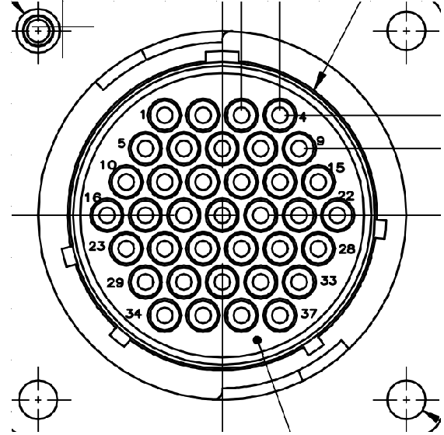
Motor Connector Diagram Legend:
P: Power
G: Ground
S: Signal
A, B, C: phases for motor
A, B, C: Digital sensor (encoder or hall)
output signals
+: One side of motor/valve
-: Other side of motor/valve
Red: Motors
Blue: Potentiometers
Yellow: Digital sensor
Board Connector: 1-206934-4 or similar
Harness Connector: 206150-1 or similar
Board pinout MIRRORS connector pinout
about the vertical axis numerically
Diagram is for connector pinout only!
Board pinout is mirrored
B
-
+
-
mtr1B
mtr1A
A
P
S
S
+
mtr2
pot2
pot1
C
S
G
G
P
pot3
B
G
P
P
G
P
S
dig0
pot0
A
A
B
P
G
G
mtr3
dig1
dig0
B
-
C
C
A
mtr0A
+
-
dig1
+
mtr0B
C
enc0

Slide 3
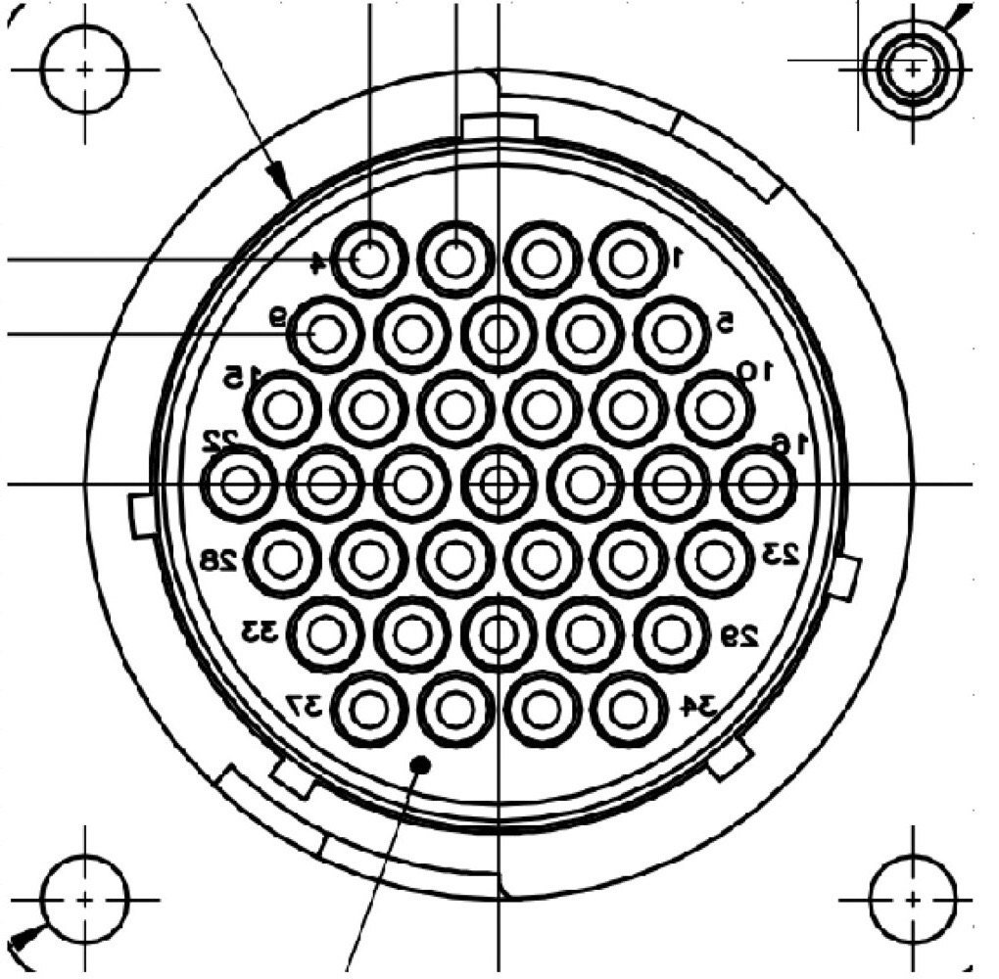
Valve & Pressure Transducer
Connector Diagram Legend:
P: Power
G: Ground
S: Signal
+: One side of motor/valve
-: Other side of motor/valve
Red: Valves
Blue: Pressure Transducers
Board Connector: 2-208224-1 or similar
Harness Connector: 206305-1 or similar
Board pinout MATCHES connector pinout
Diagram is for both
connector and board pinout
S
P
+
pt3
vlv0
S
G
S
-
+
pt4
pt1
vlv8
P
G
P
G
-
+
vlv7
S
P
S
S
P
-
-
pt5
pt2
pt0
vlv6
G
P
G
G
-
+
vlv5
-
-
-
-
+
vlv1
vlv2
vlv3
vlv4
+
+
+
+
P

